Slide 1

SWP391: FINAL PROJECT PRESENTATION
Top CV Career Connect System

Slide 2
Table of content
Project Overview
1.1 Product introduction & Scope
1.2 Team member & mentor
1.3 Project communication
Use case diagrams
Screen flow
Main screen
Database design
Package diagrams
Demonstration
Demo & QA

Slide 3
Project Overview
1.1 Product introduction & Scope
TopCV is a job recruitment platform developed as a Java Web Application, using the MVC (Model-View-Controller) architecture with the following technologies:
Backend: Java Servlets, JSP
Database: SQL Server
Frontend: HTML, CSS, JavaScript
The system includes 3 main user roles: Job Seeker, Recruiter, Admin & Staff
Including features such as: User management, Job search and discovery, Application management, Notification system, Job posting, Candidate management, Service packages, Payment processing, and Admin management functions

Slide 4
Project Overview
1.2 Team Member
Category | Brief Information
Mentor | Thầy Nguyễn Thành Ý
Project Team Members | Nguyễn Thanh Dương
 | Nguyễn Trọng Quang Minh

Slide 5
Project Overview
1.3 Project communication
Document: Google driver, Google docs
Design : draw.io, Visual Paradigm
Meet: Google meet, Zalo
Source code management: GitHub

Slide 6
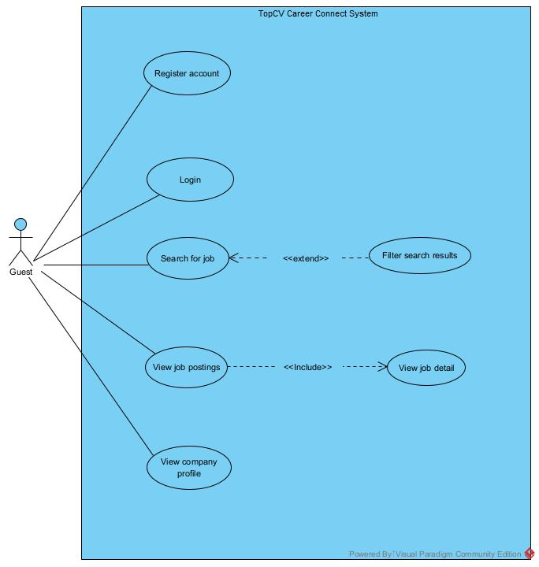
Product Requirements
Use Case Diagrams

Slide 7
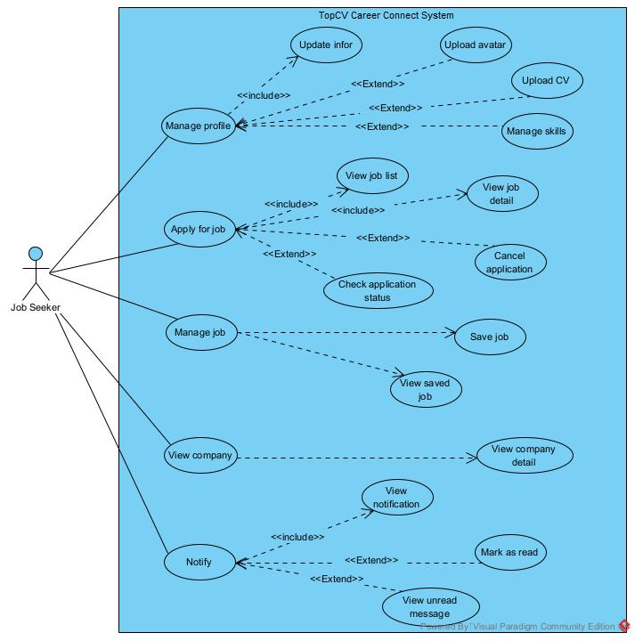
Product Requirements
Use Case Diagrams

Slide 8
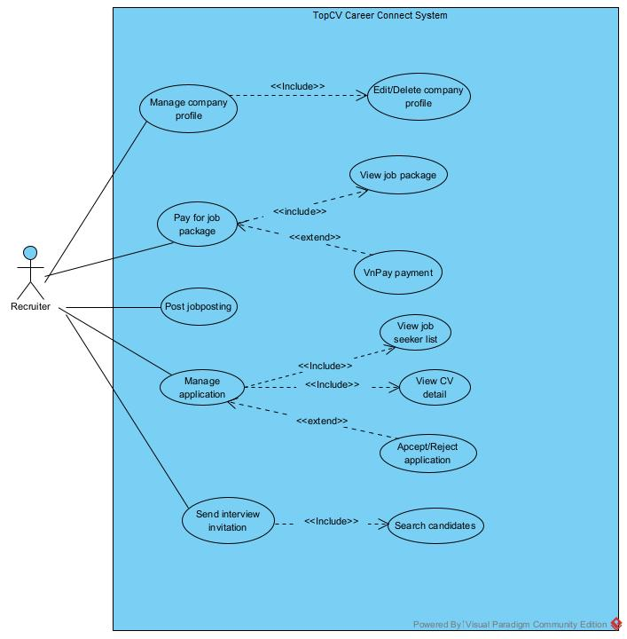
Product Requirements
Use Case Diagrams

Slide 9
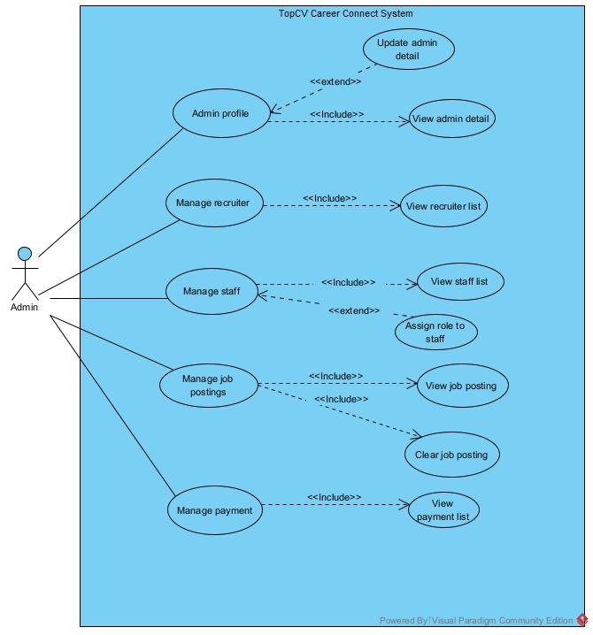
Product Requirements
Use Case Diagrams

Slide 10
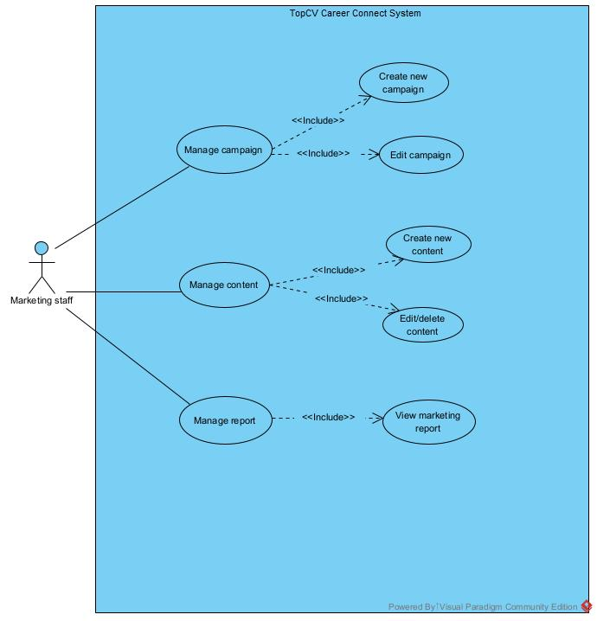
Product Requirements
Use Case Diagrams

Slide 11
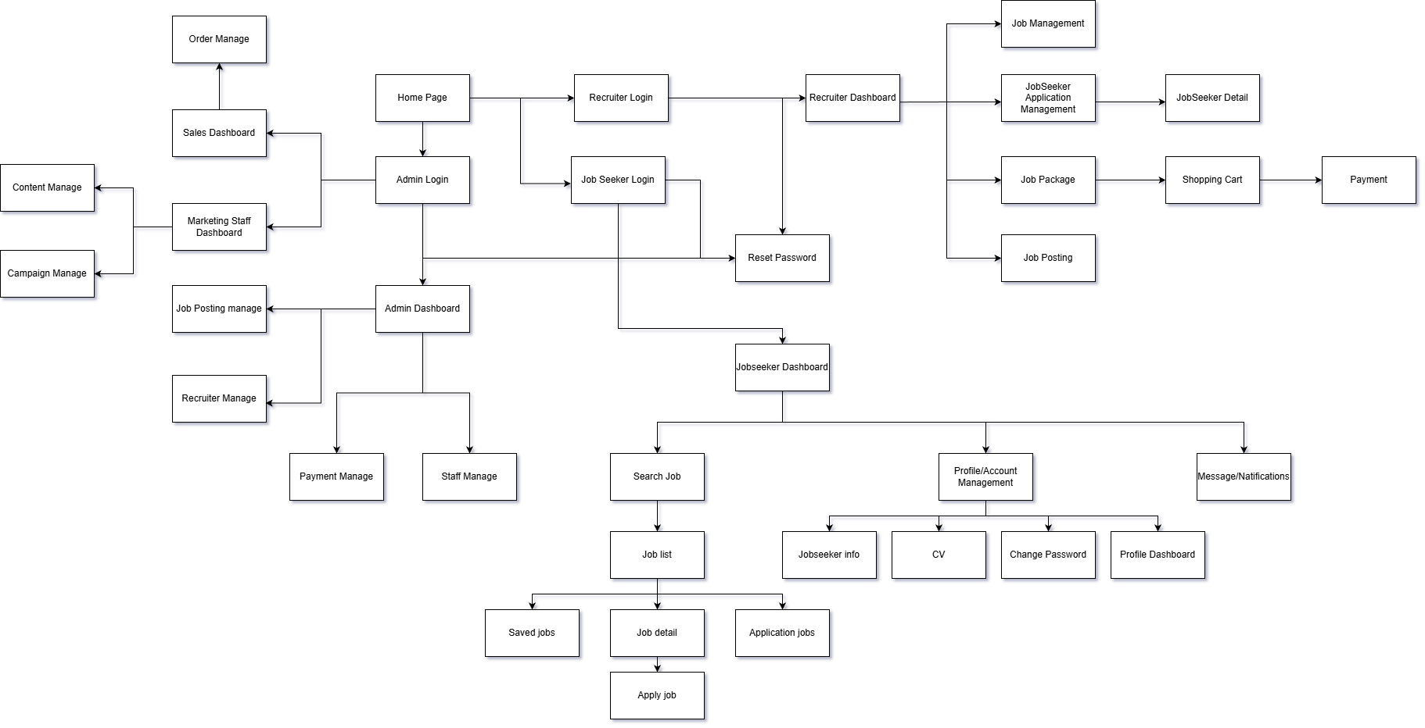
Product Requirements
Product Functionalities

Slide 12
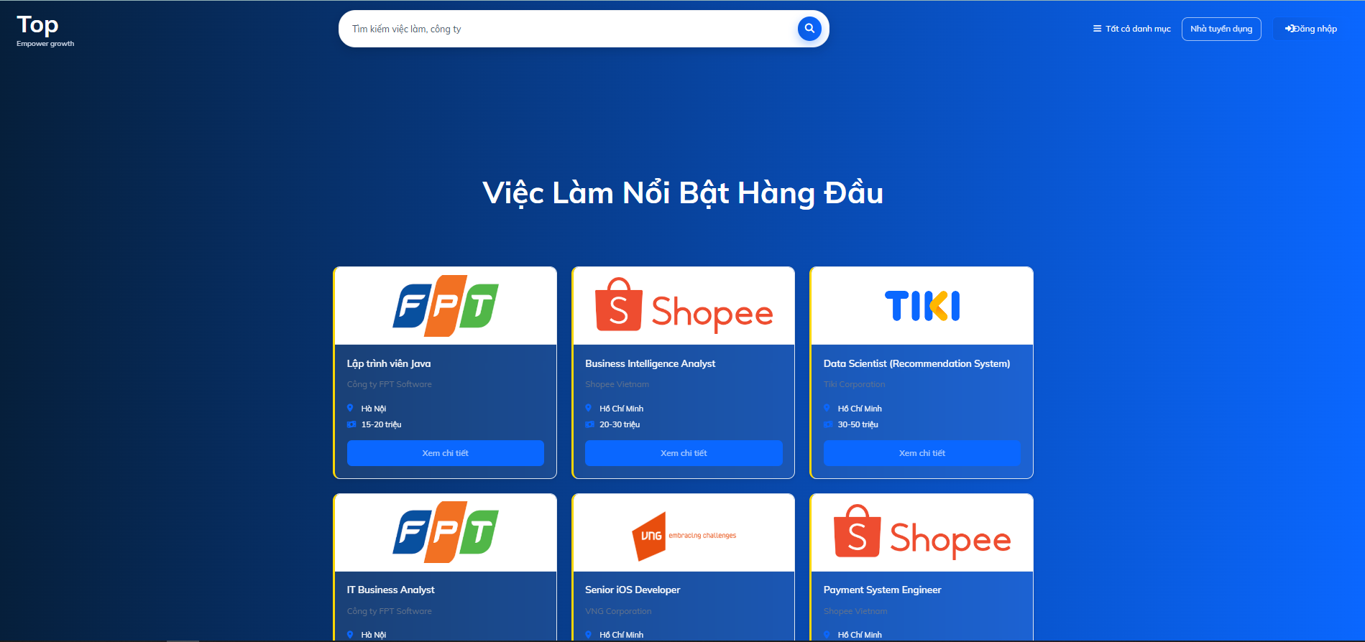
Home page

Slide 13
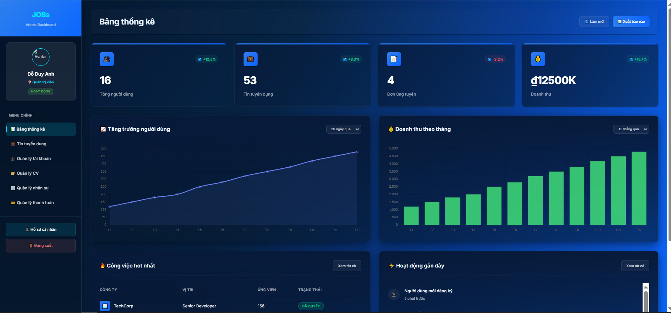
Admin dashboard

Slide 14
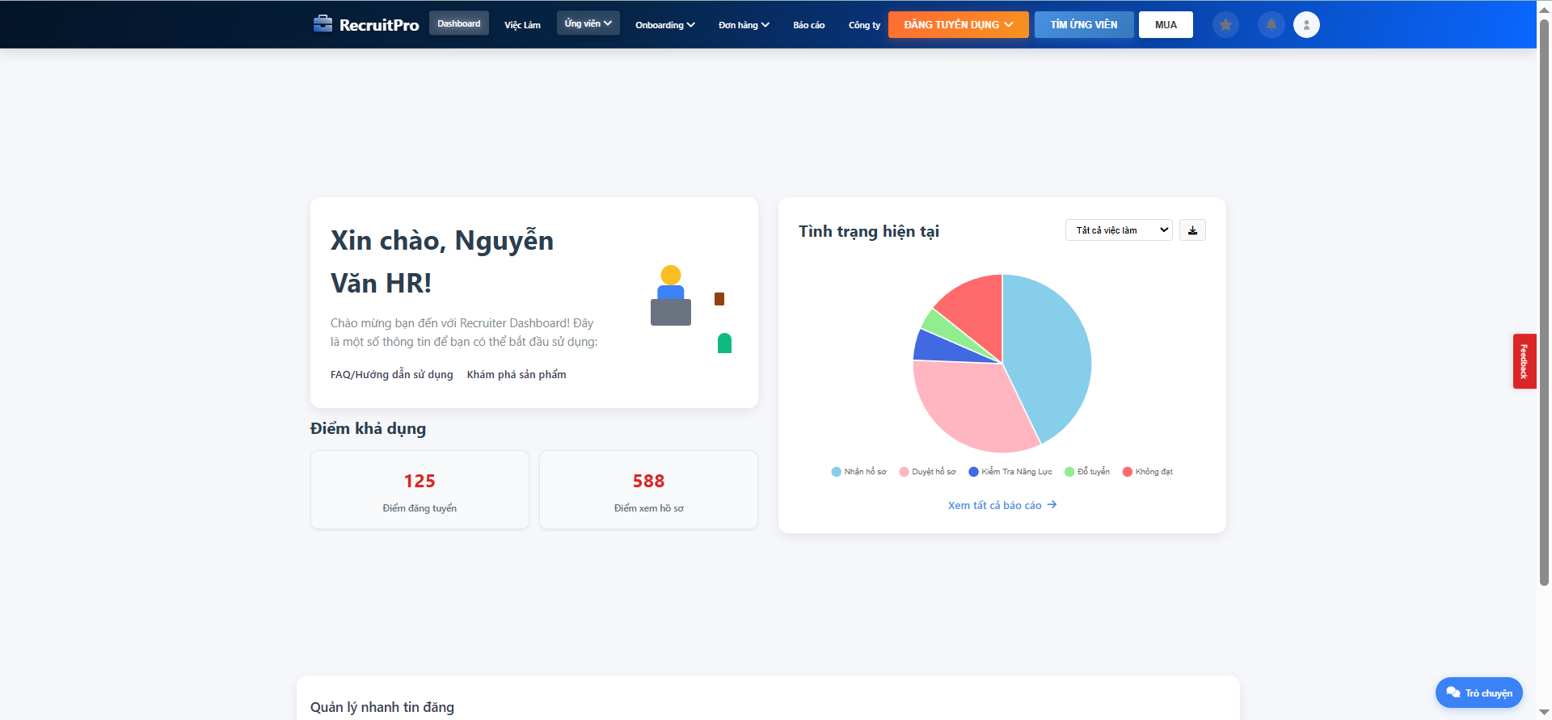
Recruiter dashboard

Slide 15
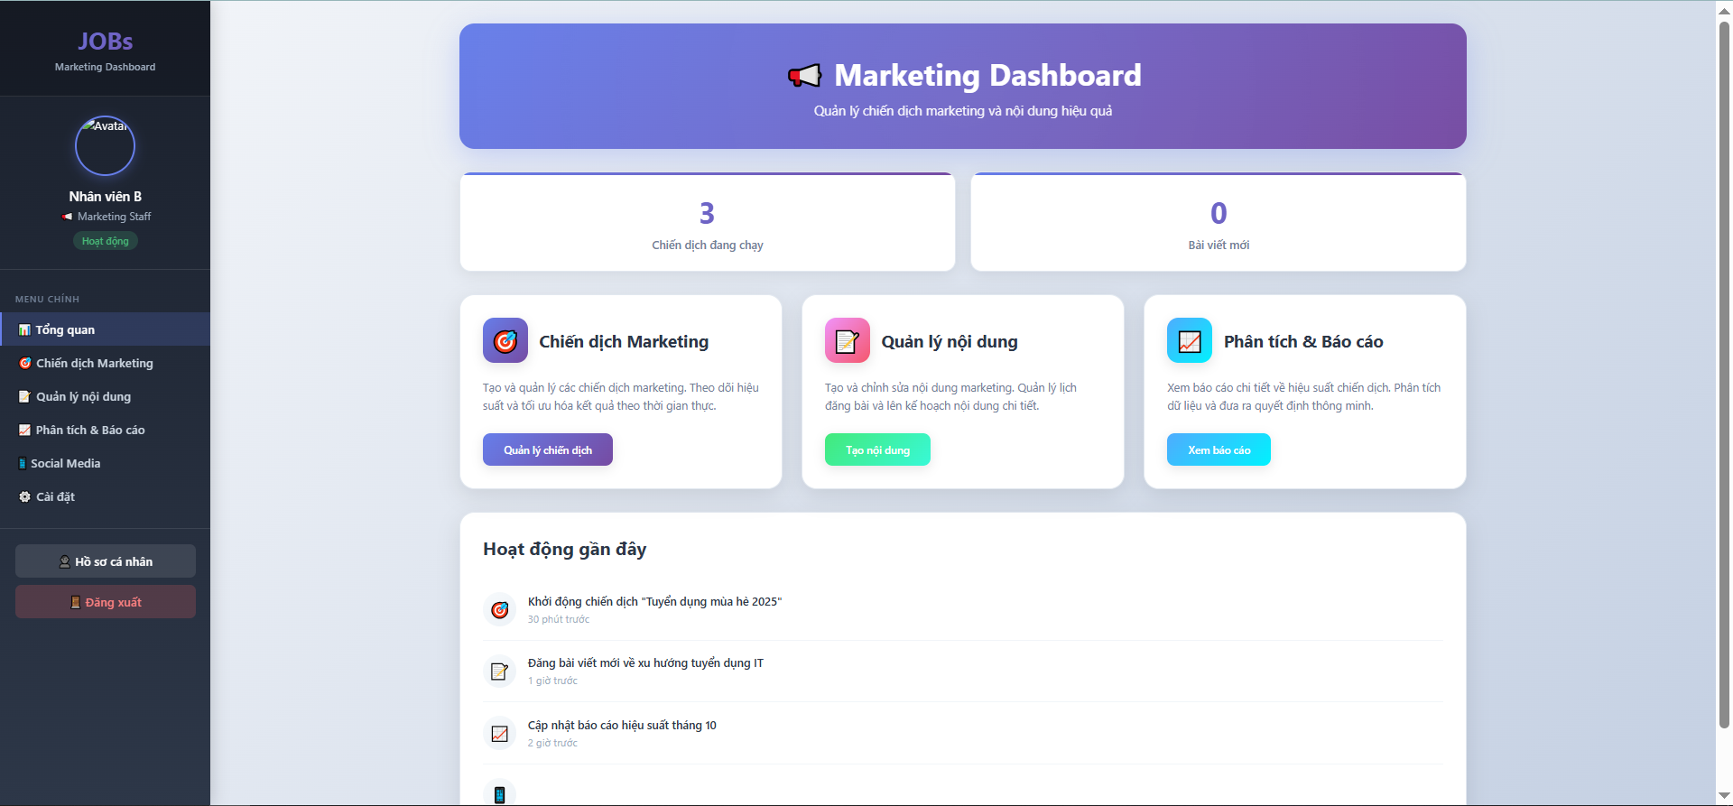
Marketing staff dashboard

Slide 16
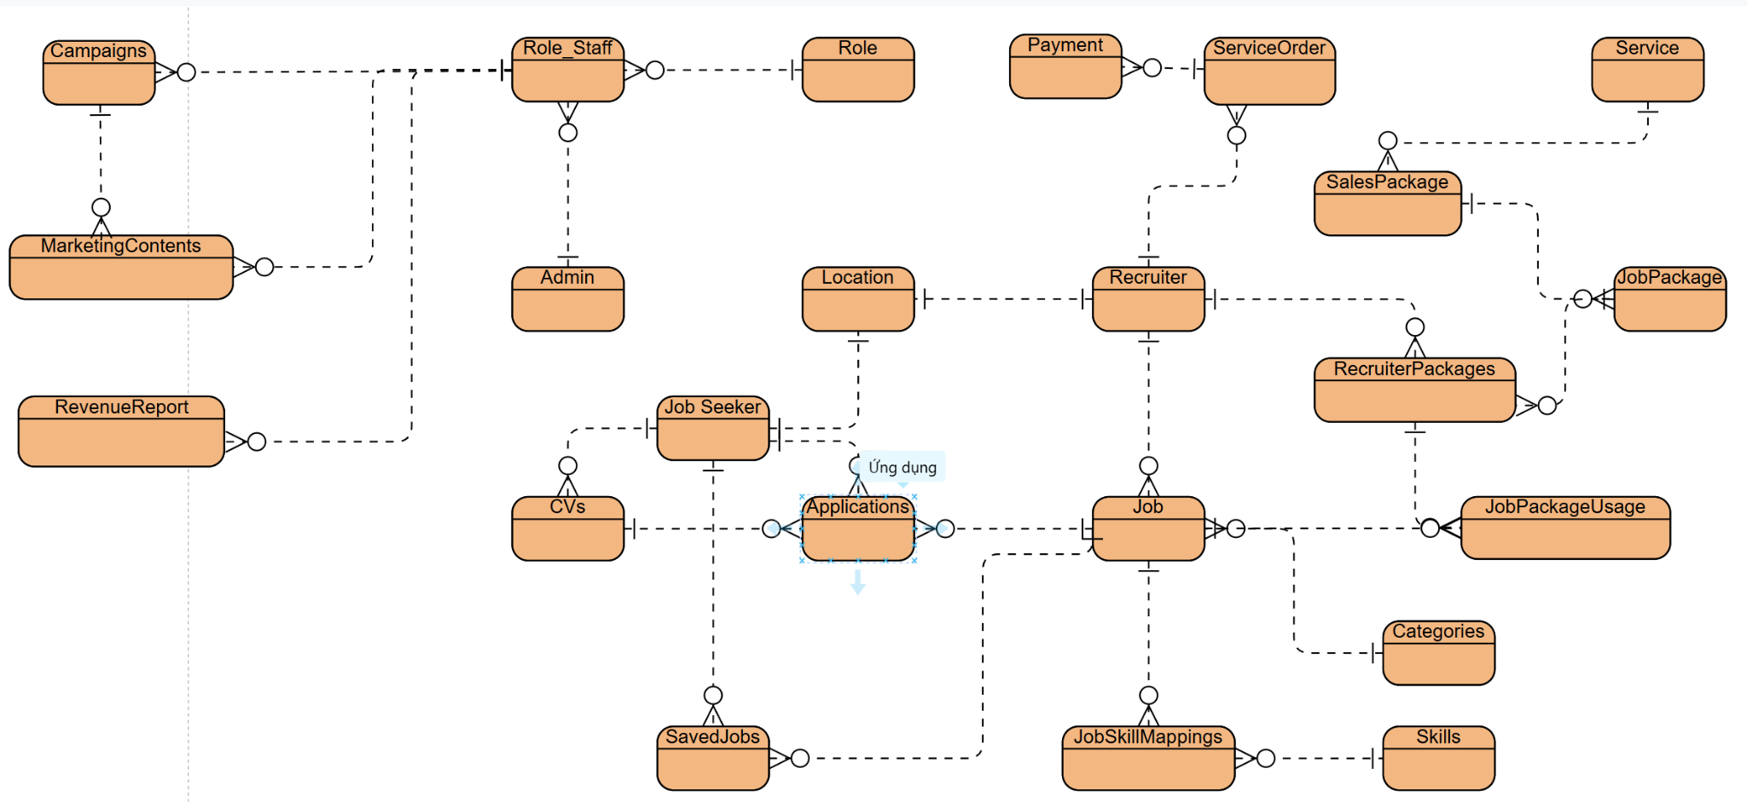
System Design
Database Design

Slide 17
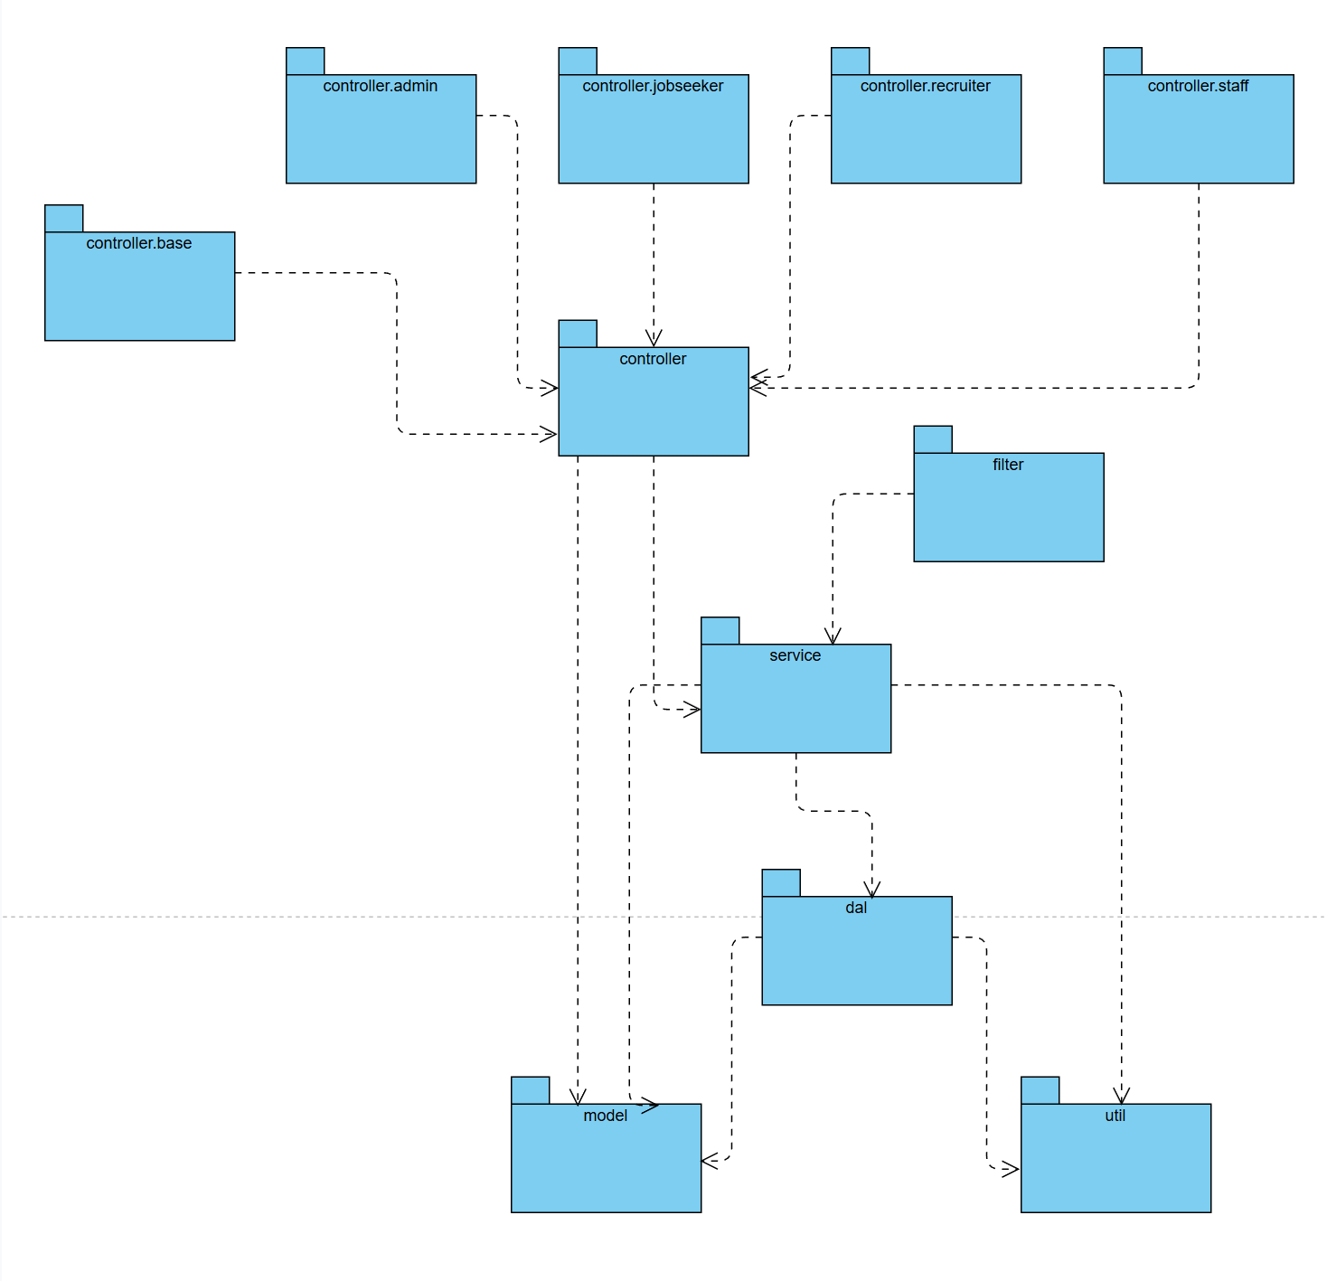
System Design
Package Diagram

Slide 18
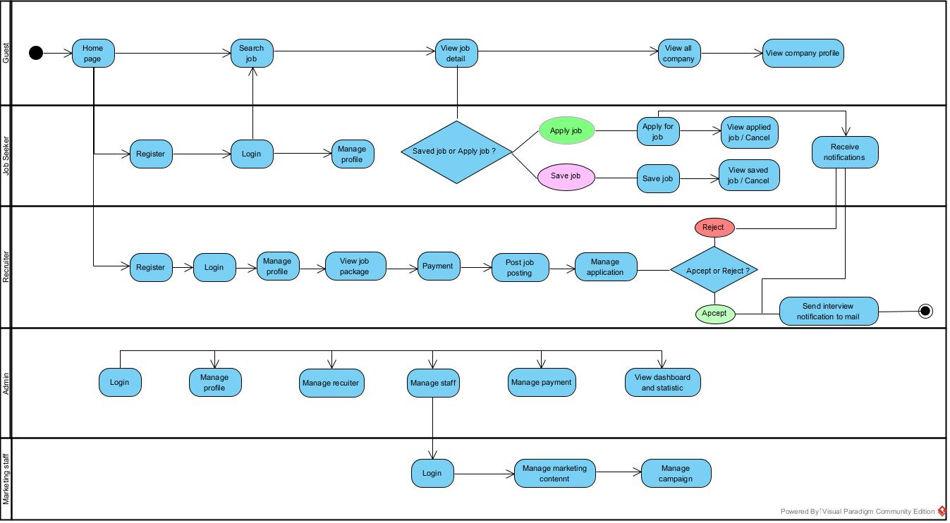
Demonstration

Slide 19
Demo Project

Slide 20


Slide 21
Thank you

